Slide 1


Effects of Sub-Atmospheric Pressures on the Temperature Evolution of Spark Kernels
Daniel Caplan and David Blunck, PhD.
SciTech, 8-12 January 2018
Kissimmee, Florida
GTE-07, Control ID 2795470

Slide 2
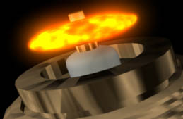
What is a Spark Kernel?
Electrodes
Spark Kernel
Illustration of a spark plug generating a spark kernel. [1]

Slide 3
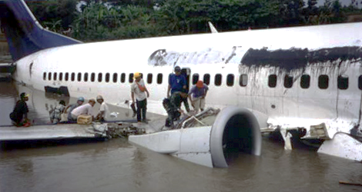
Why Study Low Pressure Ignition?
High altitude re-ignition
Afterburner ignition
Physics of re-light envelope
Improve combustor design
Garuda Indonesia Flight GA421 wreckage after dual engine flameout induced by inclement weather in 2002. (Aviation Accidents, [5])

Slide 4
Why Study Low Pressure Ignition?
High altitude re-ignition
Afterburner ignition
Physics of re-light envelope
Improve combustor design
Garuda Indonesia Flight GA421 wreckage after dual engine flameout induced by inclement weather in 2002. (Aviation Accidents, [5])

Slide 5
Why Study Low Pressure Ignition?
High altitude re-ignition
Afterburner ignition
Physics of re-light envelope
Improve combustor design
Garuda Indonesia Flight GA421 wreckage after dual engine flameout induced by inclement weather in 2002. (Aviation Accidents, [5])

Slide 6
How is Ignition Studied?
6

Slide 7
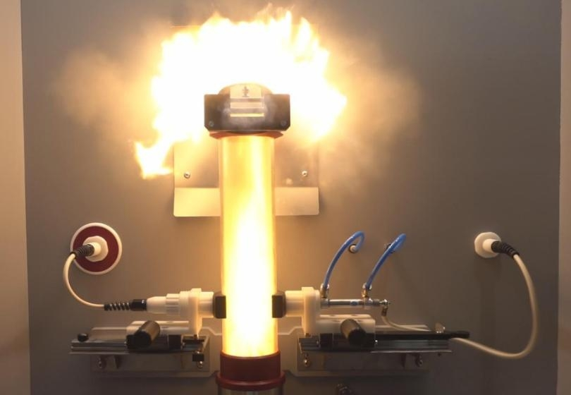
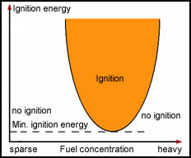
Minimum Ignition Energy (MIE)
MIE Test Rig. (Anko, [3])
MIE Graphical Representation (asdfadsf, [4])

Slide 8
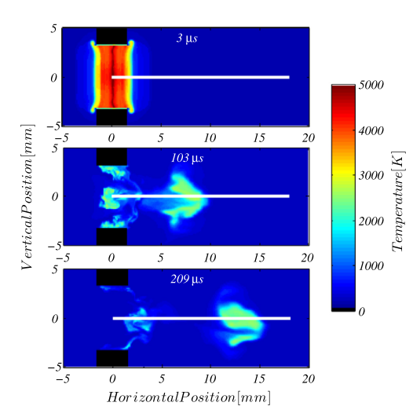
Numerical Modeling
Another Modeling Example
Modeled spark kernel in a cross flow of air. (Sforzo et al., [2])

Slide 9
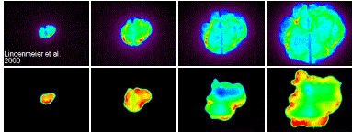
Spark Kernels: Reacting
Chemiluminescence
OH* PLIF
Chemiluminescence and OH* Planar Laser Induced Fluorescence (PLIF) images of spark ignition in a piston engine. (Karlsruhe Institute of Technology, [5])

Slide 10
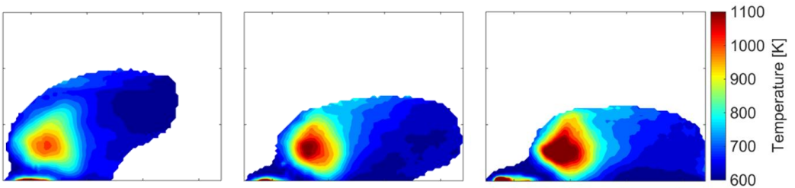
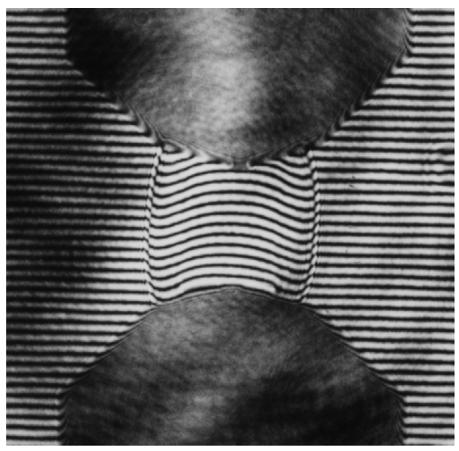
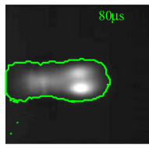
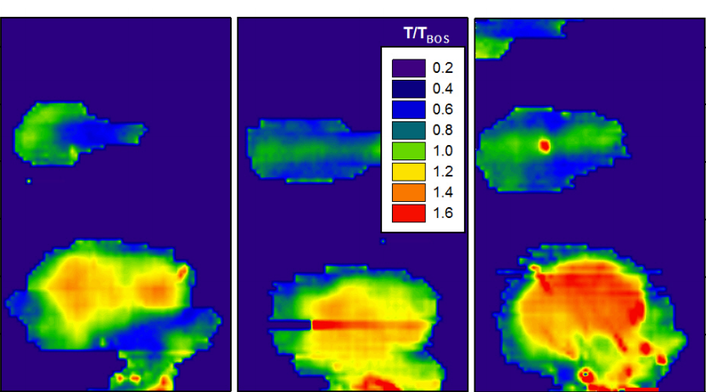
Spark Kernels: Non-Reacting
Interferogram photograph of a spark kernel shock wave in nitrogen. (Topham et al., [6])
Time resolved IR thermography temperatures of a spark kernel in a crossflow of air (Okhovat et al. [#])
Laser-Schlieren image of a spark kernel in a crossflow of air. (Sforzo et al. [2])
Time resolved IR thermography temperatures of a spark kernel in quiescent air (Blunck et al. [#])

Slide 11
The Experiment
11

Slide 12
Goals
Spatially resolved intensities and temperatures
Effects of decreasing pressure
Possible links to ignition altitude envelope

Slide 13
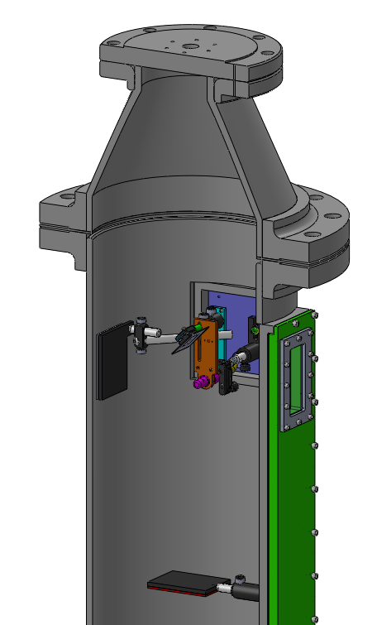
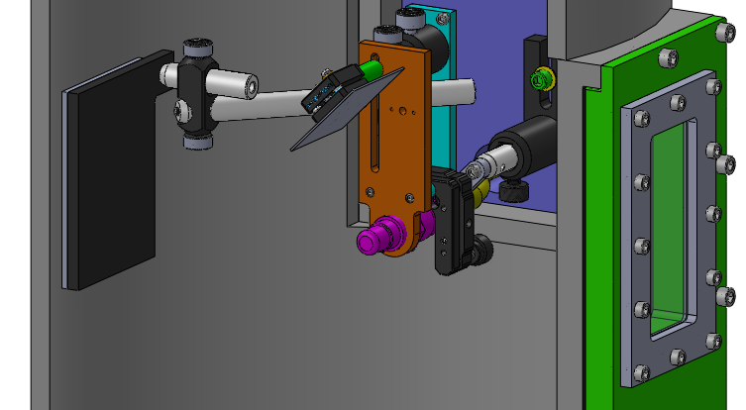
Experimental Setup
Venturi Vacuum Ejector
Mirror
Camera
Igniter
Heated Back Plate
Sapphire Window
Gas Analyzer
Heated Back Plate
CAD images of igniter jig inside vacuum chamber

Slide 14
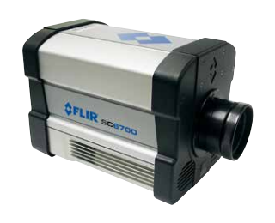
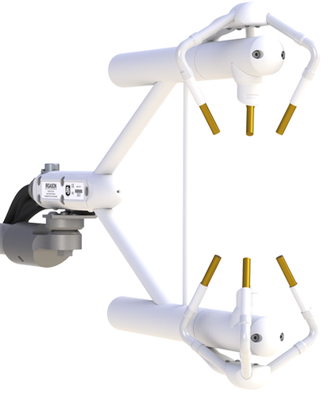
Data Collection
Camera: FLIR SC6700
MWIR InSb Detector, 1-5 μm
Blackbody calibrated
~1500 Hz
Gas Analyzer: IRGASON
H2O and CO2 concentrations
Ambient Temperature and Pressure
FLIR SC6700 IR Camera [7]
Campbell Scientific IRGASON gas analyzer [8]

Slide 15
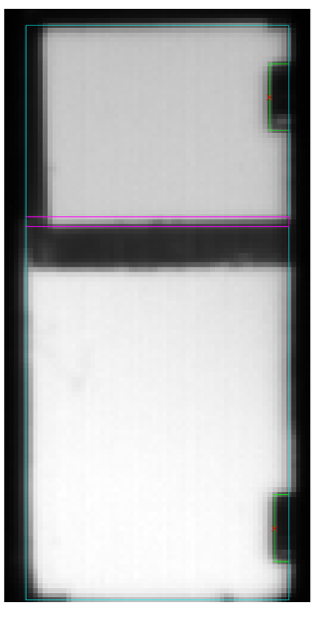
Experimental Setup
Photo of chamber with igniter inside

Slide 16

Deconvolution Technique
Radiation transfer equation for a participating medium:
Spectral Intensity
Incident Radiation
Emitted Radiation
( )
Composition
Path Length
Temperature
Pressure
Solve for temperature, measuring everything else
Intensity = function of

Slide 17
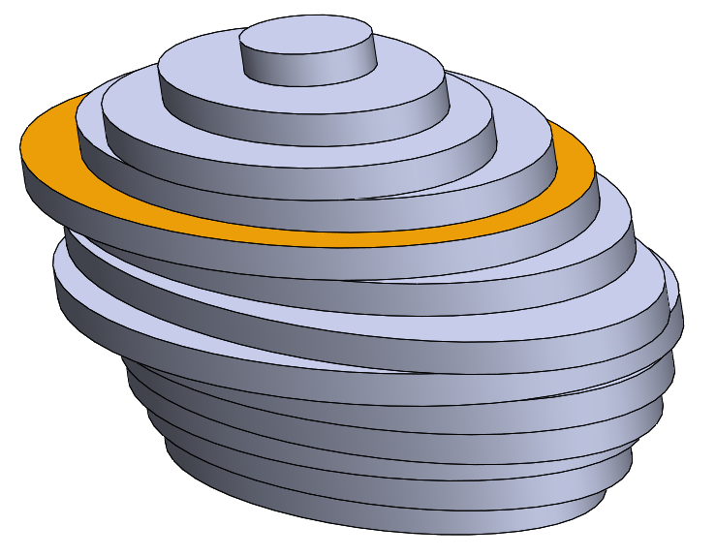
Determining Path Length
Mirror
Depth Axis
Reflected
Camera
Width
Axis
Line of Sight
Kernel approximated as stack of ellipsoid slices

Slide 18
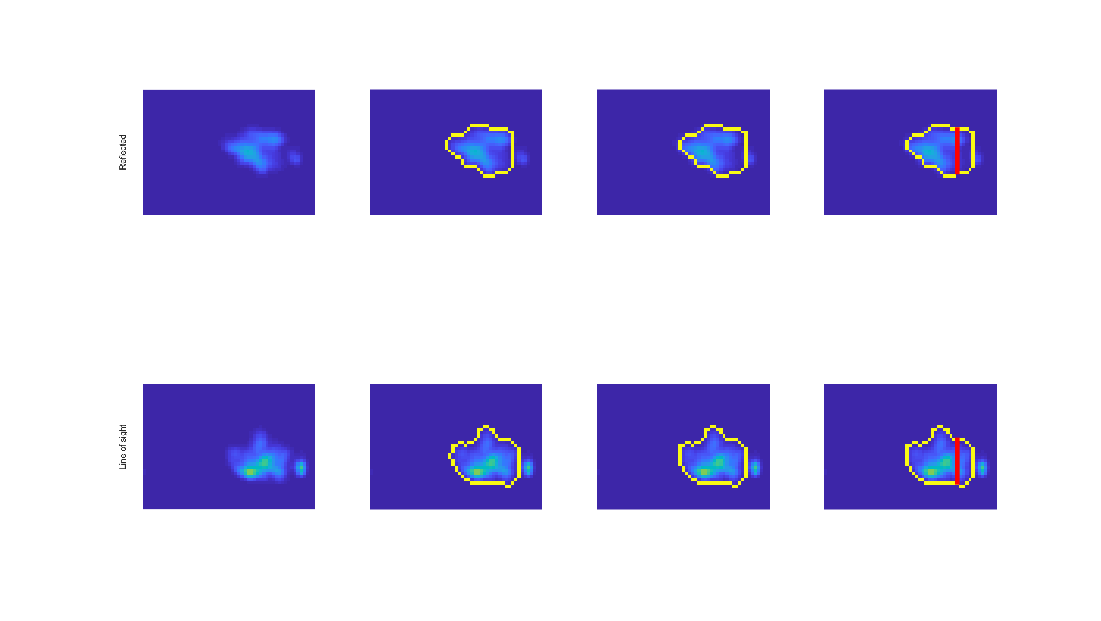
Determining Ellipse Axes
Reflected
Igniter Tip
Line of Sight
Kernel Intensity
Edge Detection
Align Tip
Ellipse Axes
Notes:
2017_12_19, DP8, {1,1}

Slide 19
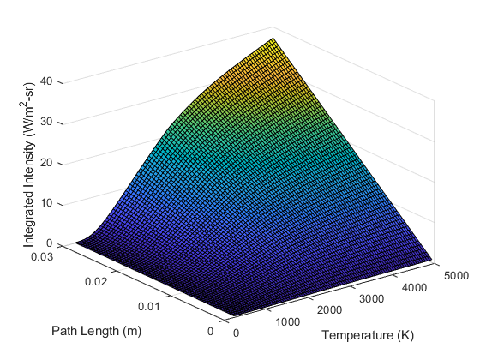
Temperature Interpolation Surface
Built using Radcal [7]
For each combination:
Composition
Pressure

Slide 20


Intensity to Temperature
Intensity image…
Temperature imge…

Slide 21
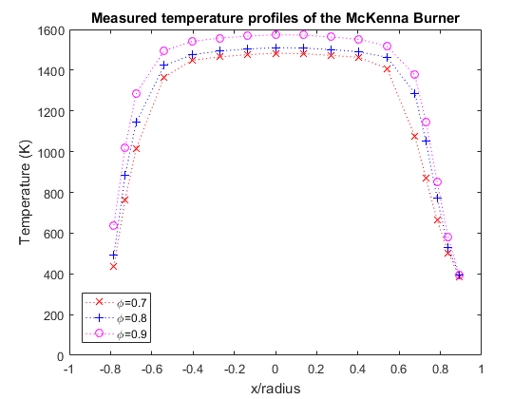
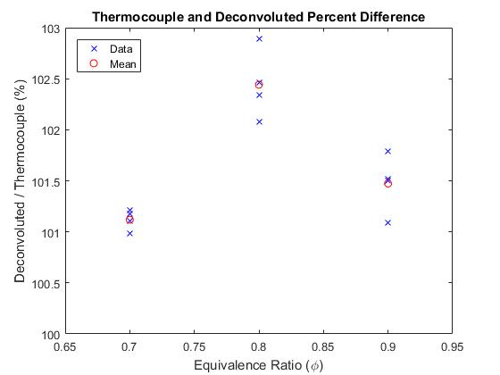
Technique Evaluation

Slide 22
Results
22

Slide 23
Kernel Intensities
1.0 atm video
0.6 atm video
0.3 atm video
At Lower Pressure:
decreased radiation emissions
shorter detectable duration
Increased rate of bifurcation
more material ablation

Slide 24
Kernel Temperatures
1.0 atm video
0.6 atm video
0.3 atm video

Slide 25
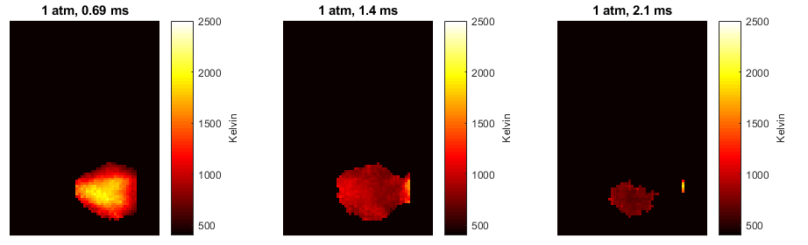

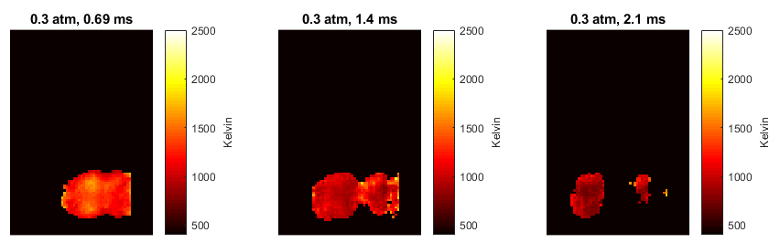
Phase Average Temperature

Slide 26
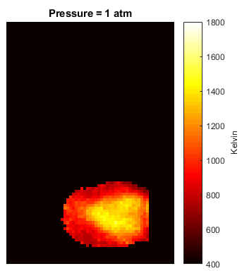


Average Temperature
At Lower Pressure:
Lower temperatures
sdsdfa

Slide 27
Summary and Conclusions
At lower pressures:
Radiation emissions are lower.
Temperatures are lower.
There is more material ablation.

Slide 28
Acknowledgements
Air Force Research Laboratory (Craig Neuroth) for use of igniter equipment
Oregon State University for funding
OSU Propulsion Laboratory (Jonathan Bonebrake and Nathan Schorn) for use of the vacuum chamber
OSU Water Resources Engineering (Chad Higgins) for use of the gas analyzer
Bryan Cmelak and Tyler Castile for help with manufacturing and data collection

Slide 29
Sources
[1] http://www.aviation-accidents.net/garuda-indonesia-boeing-b737-300-pk-gwa-flight-ga421/
[2] Sforzo, B., Lambert, A., Kim, J., Jagoda, J., Menon, S., and Seitzman, J., “Post discharge evolution of a spark igniter kernel,” Combustion and Flame, Vol. 162, No. 1, 2015, pp. 181–190.
[3] http://anko-lab.com/en/a/apparatus-for-determination-of-minimum-ignition-energy-of-a-dust-air-mixtures
[4] http://www.exschutz.net/en/basic-information-on-explosions.html
[5] http://www.itt.kit.edu/english/323.php
[6] Reinmann, R. and Akram, M., “Temporal investigation of a fast spark discharge in hemically inert gases,” Journal of Physics D: Applied Physics, Vol. 30, No. 7, 1997, pp. 1125.
[7] Grosshandler, W. L., “RADCAL: A Narrow-Band Model for Radiation Calculations in a Combustion Environment,” 1993.
[8] https://www.campbellsci.com/irgason
[9] http://www.suprasport.com/E3-Spark-Plugs_p_1520.html

